Slide 1

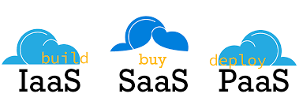
Course code : CSE4001 Course title : Cloud Computing Module : 5 Topic : 3
Cloud Delivery Models

Slide 2
Objectives
This session will give the knowledge about
14.1 Cloud Delivery Models: The Cloud Provider Perspective
14.2 Cloud Delivery Models: The Cloud Consumer Perspective
14.3 Case Study Example

Slide 3
The Cloud Consumer Perspective
Working with IaaS Environments
Working with PaaS Environments
Working with SaaS Services

Slide 4
2. Working with PaaS Environments
A typical PaaS IDE can offer a wide range of tools and programming resources, such as software libraries, class libraries, frameworks, APIs, and various runtime capabilities that emulate the intended cloud-based deployment environment.
These features allow developers to create, test, and run application code within the cloud or locally (on-premise) while using the IDE to emulate the cloud deployment environment.
Compiled or completed applications are then bundled and uploaded to the cloud, and deployed via the ready-made environments. This deployment process can also be controlled through the IDE.

Slide 5
PaaS also allows for applications to use cloud storage devices as independent data storing systems for holding development-specific data (for example in a repository that is available outside of the cloud environment).
Both SQL and NoSQL database structures are generally supported.

Slide 6
IT Resource Provisioning Considerations
PaaS environments provide less administrative control than IaaS environments, but still offer a significant range of management features.
For example:
•establishing and displaying service provisioning agreements, such as account conditions and usage terms
•selecting software platform and development frameworks for ready-made environments
•selecting instance types, which are most commonly frontend or backend instances

Slide 7
•selecting cloud storage devices for use in ready-made environments
•controlling the lifecycle of PaaS-developed applications (deployment, starting, shutdown, restarting, and release)
•controlling the versioning of deployed applications and modules
•configuring availability and reliability-related mechanisms
•managing credentials for developers and cloud resource administrators using IAM

Slide 8
•managing general security settings, such as accessible network ports
•selecting and monitoring PaaS-related SLA metrics
•managing and monitoring usage and IT resource costs
•controlling scalability features such as usage quotas, active instance thresholds, and the configuration and deployment of the automated scaling listener and load balancer mechanisms

Slide 9
The usage and administration portal that is used to access PaaS management features can provide the feature of pre-emptively selecting the times at which an IT resource is started and stopped.
For example, a cloud resource administrator can set a cloud storage device to turn itself on at 9:00AM then turn off twelve hours later. Building on this system can enable the option of having the ready-made environment self-activate upon receiving data requests for a particular application and turn off after an extended period of inactivity.

Slide 10
3. Working with SaaS Environments
Because SaaS-based cloud services are almost always accompanied by refined and generic APIs, they are usually designed to be incorporated as part of larger distributed solutions.
A common example of this is Google Maps, which offers a comprehensive API that enables mapping information and images to be incorporated into Web sites and Web-based applications.

Slide 11
Many SaaS offerings are provided free of charge, although these cloud services often come with data collecting sub-programs that harvest usage data for the benefit of the cloud provider.
When using any SaaS product that is sponsored by third parties, there is a reasonable chance that it is performing a form of background information gathering. Reading the cloud provider’s agreement will usually help shed light on any secondary activity that the cloud service is designed to perform.

Slide 12
Customization options are usually available to cloud consumers; however, these options are generally limited to the runtime usage control of the cloud service instances that are generated specifically by and for the cloud consumer.
For example:
•managing security-related configurations
•managing select availability and reliability options
•managing usage costs
•managing user accounts, profiles, and access authorization
•selecting and monitoring SLAs
•setting manual and automated scalability options and limitations

Slide 13
Summary
Consumer Perspective:
Working with PaaS
IT Resource Provisioning Considerations
Working with SaaS
IT Resource Provisioning Considerations

Slide 14
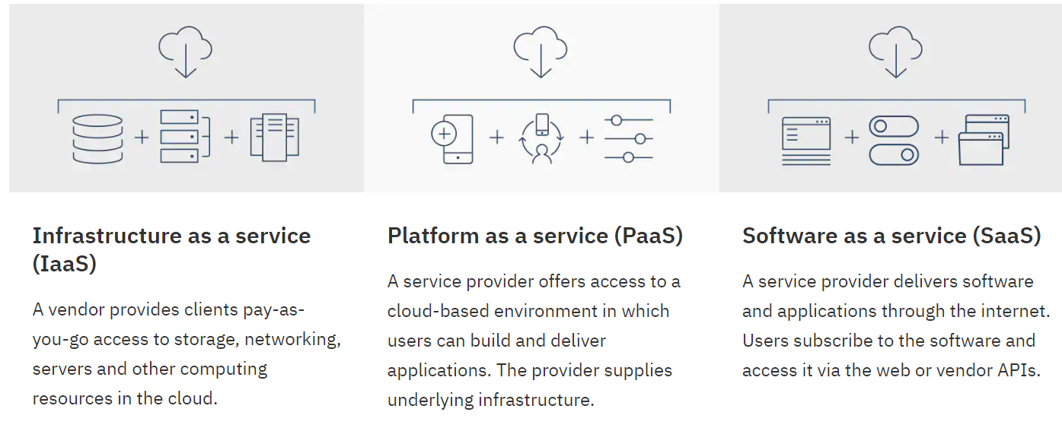
Defining IaaS, PaaS, SaaS

Slide 15
IaaS
Infrastructure as a service (IaaS) is a cloud computing offering in which a vendor provides users access to computing resources such as servers, storage and networking. Organizations use their own platforms and applications within a service provider’s infrastructure.
Key features
Instead of purchasing hardware outright, users pay for IaaS on demand.
Infrastructure is scalable depending on processing and storage needs.
Saves enterprises the costs of buying and maintaining their own hardware.
Because data is on the cloud, there can be no single point of failure.
Enables the virtualization of administrative tasks, freeing up time for other work.

Slide 16
PaaS
Platform as a service (PaaS) is a cloud computing offering that provides users with a cloud environment in which they can develop, manage and deliver applications. In addition to storage and other computing resources, users are able to use a suite of prebuilt tools to develop, customize and test their own applications.
Key features
PaaS provides a platform with tools to test, develop and host applications in the same environment.
Enables organizations to focus on development without having to worry about underlying infrastructure.
Providers manage security, operating systems, server software and backups.
Facilitates collaborative work even if teams work remotely.

Slide 17
SaaS
Software as a service (SaaS) is a cloud computing offering that provides users with access to a vendor’s cloud-based software. Users do not install applications on their local devices. Instead, the applications reside on a remote cloud network accessed through the web or an API. Through the application, users can store and analyze data and collaborate on projects.
Key features
SaaS vendors provide users with software and applications via a subscription model.
Users do not have to manage, install or upgrade software; SaaS providers manage this.
Data is secure in the cloud; equipment failure does not result in loss of data.
Use of resources can be scaled depending on service needs.
Applications are accessible from almost any internet-connected device, from virtually anywhere in the world.

Slide 18
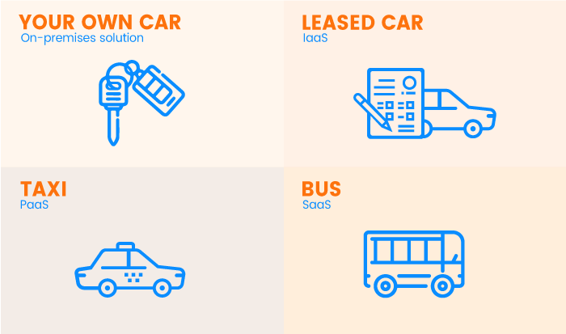

Slide 19
Thank You!

Slide 20
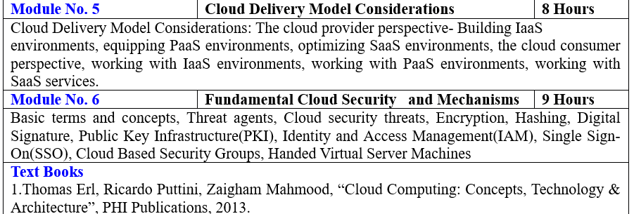

Slide 21
Reference
https://timesofcloud.com/cloud-tutorial/cloud-providers/
https://www.ibm.com/in-en/cloud/learn/iaas-paas-saas

